Slide 1
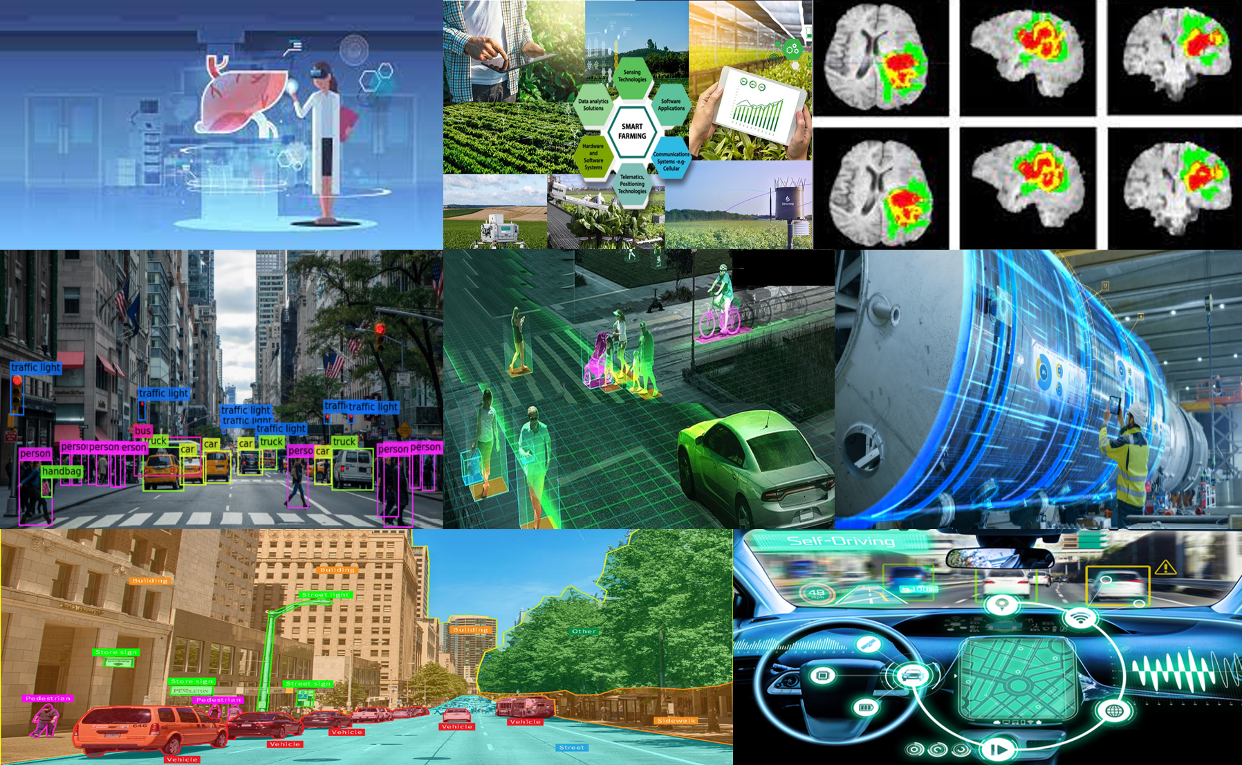
Introduction to Image Restoration and Computer Vision
Dr. Jiji C. V.
Professor, Dept. of ECE,
SRM University – AP
05/12/2022

Slide 2
Contents
Image Restoration- conventional solutions
Computer Vision – conventional solutions
Why DL for Image Restoration and Computer Vision
What all we cover in this winter school ?
CNN
GAN
Transformers
Hands on Sessions
Project
Competition

Slide 3
Image Restoration
Degraded input image: Clean output image
Image Enhancement and Image Restoration
Image Enhancement : subjective
Intensity transformations
Contrast enhancement
Histogram processing
Spatial filtering

Slide 4
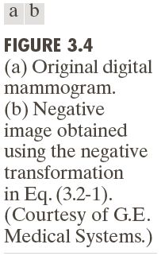
Example: Image Negatives
Small lesion

Slide 5
Example: Log Transformations

Slide 6


Slide 9
Example: Combining Spatial Enhancement Methods Goal: Enhance the image by sharpening it and by bringing out more of the skeletal detail

Slide 10
Image Restoration
In contrast to image enhancement, in image restoration, the degradation is modelled, this enables the effects of the degradation to be (largely) removed.
Image degradations
Motion blur
Defocus blur
Resolution
Noise
Haze
Poor lighting

Slide 11
Linear, Position-Invariant Degradations

Slide 12
Linear, Position-Invariant Degradations

Slide 13
Conventional Solutions
The Inverse Filter
The Wiener filter
MAP formulation
Wavelets and other transform domain approach.

Slide 14
Inverse Filtering

Slide 15
Minimum Mean Square Error (Wiener) Filtering
N. Wiener (1942)
Objective
Find an estimate of the uncorrupted image such that the mean square error between them is minimized

Slide 16
Minimum Mean Square Error (Wiener) Filtering

Slide 17
Maximum a posteriori (MAP) estimation
For an image with n pixels, write this process as ˆg = A f + n where ˆg and f are n-vectors, and A is an n × n matrix.
Estimate f(x,y) by optimizing a cost function:
f = arg min (g − Af)² + λp (f)
Likelihood function and prior

Slide 18
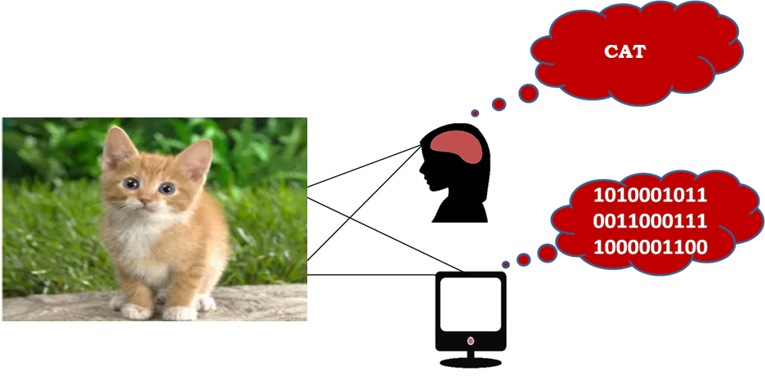
Computer Vision
Bridge gap between human and machine understanding

Slide 19
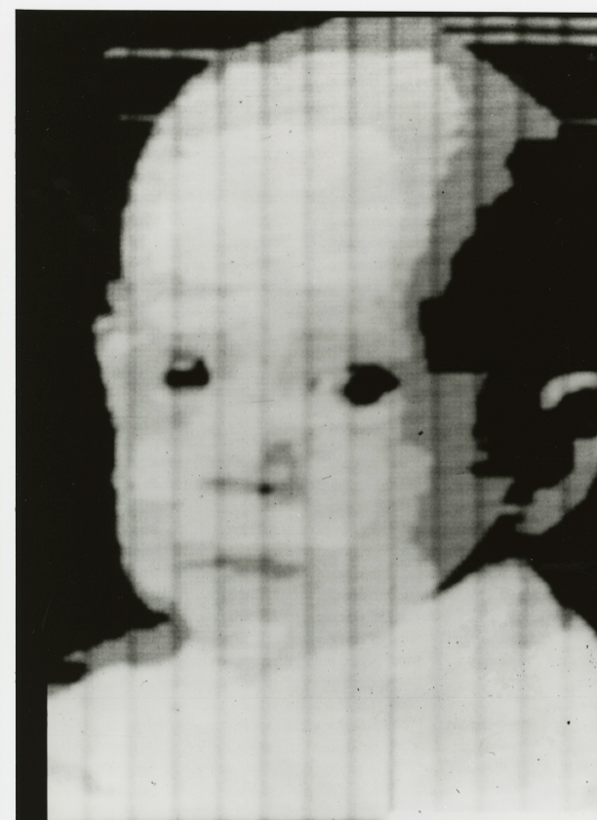

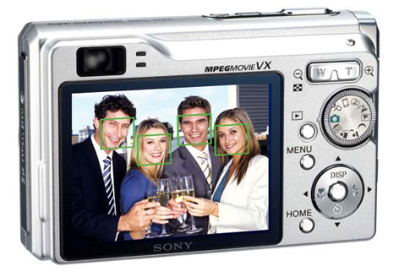
Computer Vision-Major Milestones
1959
1963
1974
1982
1991
2001
2012
2014
AI emerges to solve computer vision
Detect edges Corners
Face Recognition: Eigen Faces
AlexNet for Image Classification
GAN for Image Generation
Optical Character Recognition
Viola Jones Face Detection
Image Scanning
Scanning an image into a computer started in 1959 and in 2014 computers started created images by themselves

Slide 20
A Move towards Higher Form of Intelligence
Recognition
Generation
Creation
A human can recognise things, generate new ideas based on existing and create total new ideas. Computer vision researchers are making computers do the same

Slide 21
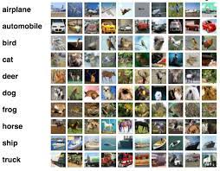

Recognition: Image Classification
CIFAR 10
10 object classes
50000 training images
10,000 test images
Accuracy: 99.5%
IMAGENET
1000 object classes
1,281,167 training images
100,000 test images
Top 1 Accuracy: 90.88%
Image classification on standard datasets have achieved good Accuracy

Slide 22
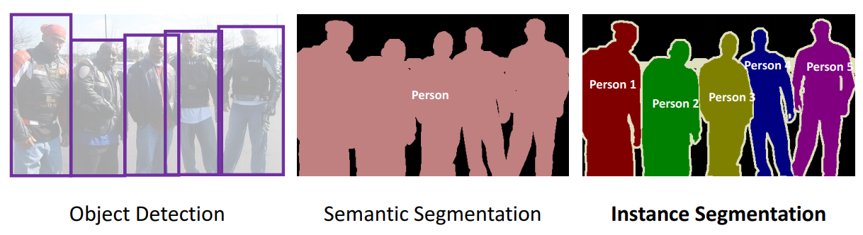
Recognition: Object Detection
Task varies from simple object detection to semantic segmentation to instance segmentation
Object Detection: draws bounding boxes around objects
Semantic segmentation: pixelwise segmentation of object
instance segmentation: segments multiple objects of the same class as distinct individual instances

Slide 23
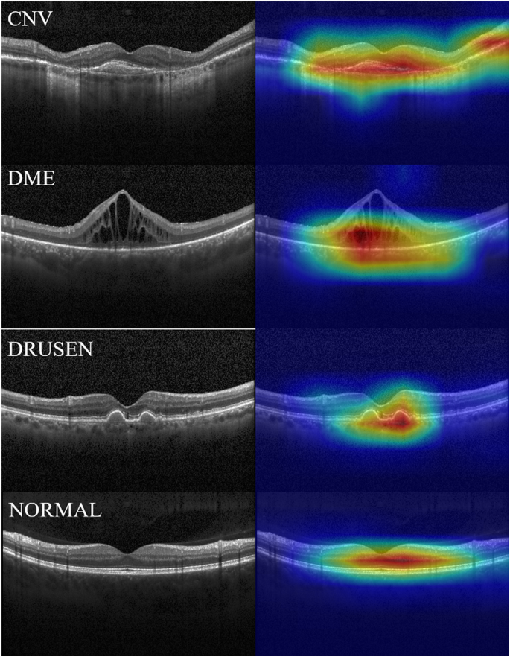
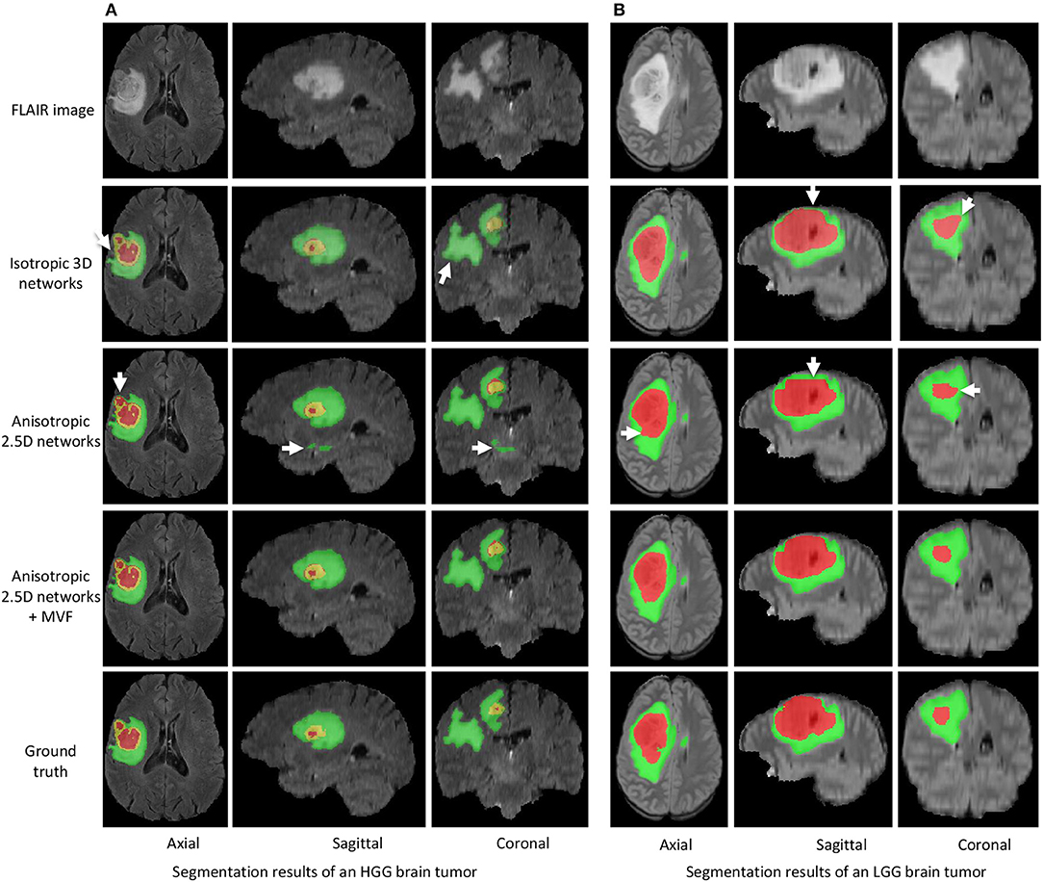
Recognition: Medical Image Classification and Segmentation
OCT Image Classification
Tumor Segmentation

Slide 24
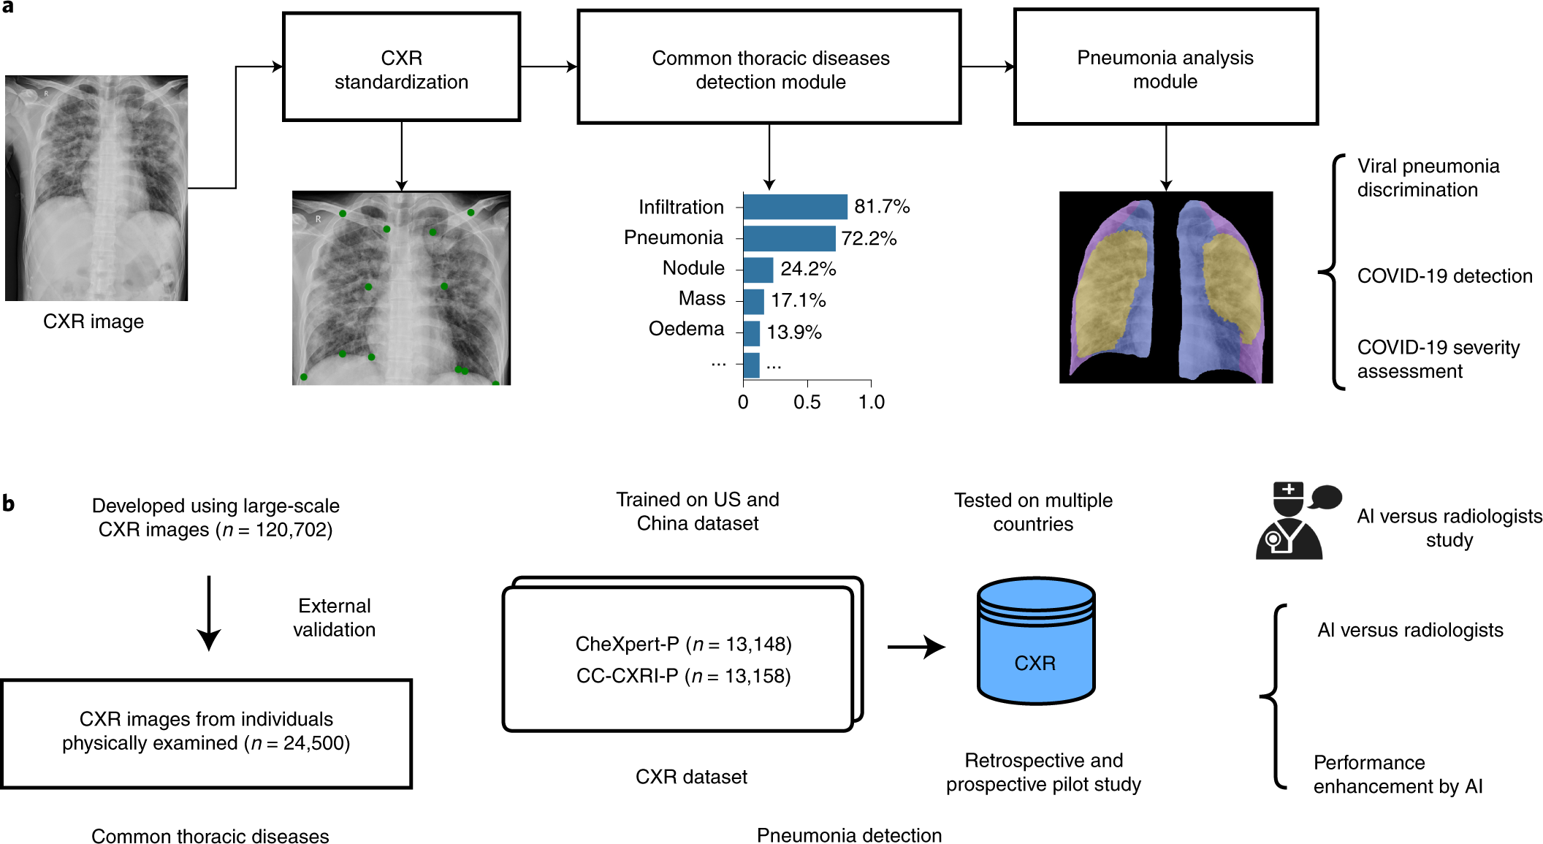
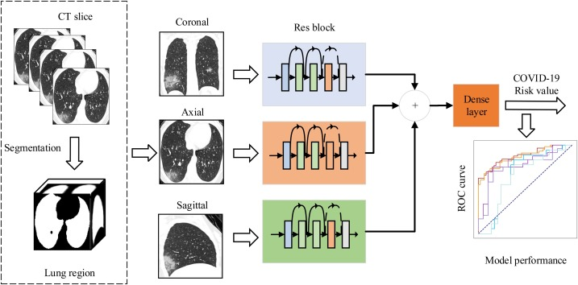
Recognition: Medical Image Classification and Segmentation
Chest XRay
CT Scan
A number of works on Covid Detection were developed in short span of time

Slide 25
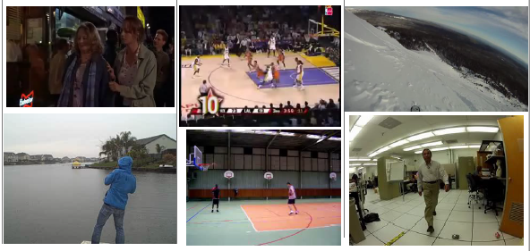
Recognition: Video Understanding
Involves labeling events in a given video

Slide 26
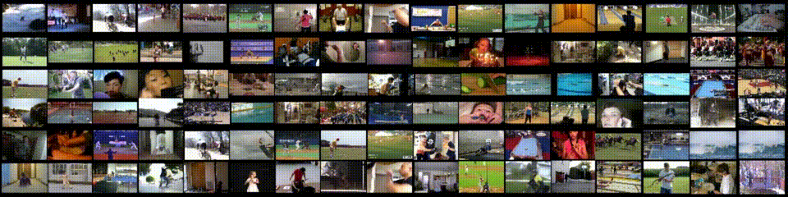
Recognition: Large scale activity recognition
Involves labeling large number of classes of actions using a machine learning model

Slide 27
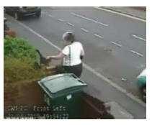
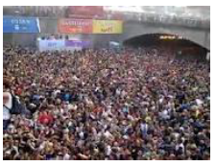
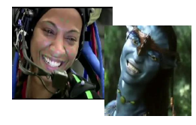
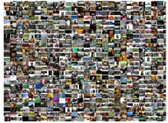
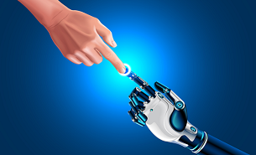
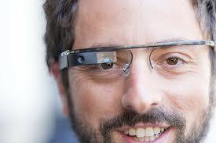
Recognition: Video Understanding
Automated
surveillance
Crowd behavior analysis
Motion capture and animation
Unconstrained Video Search
Human computer interaction
Wearable devices
Applications of video understanding

Slide 28
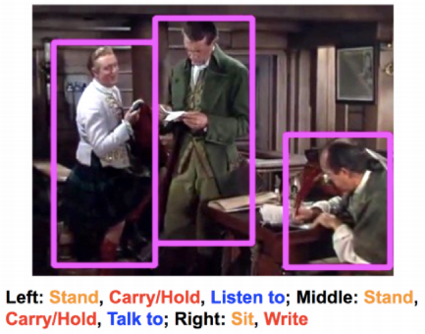
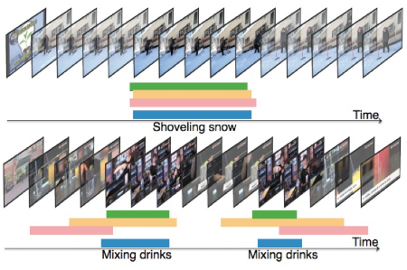
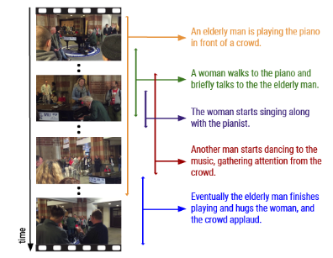
Recognition: Video Understanding
Dense Captioning
Spatio-temporal action localization
Temporal action localization
Other tasks involve generating caption for a video, temporal annotation of actions and spatio temporal localization of actions

Slide 29
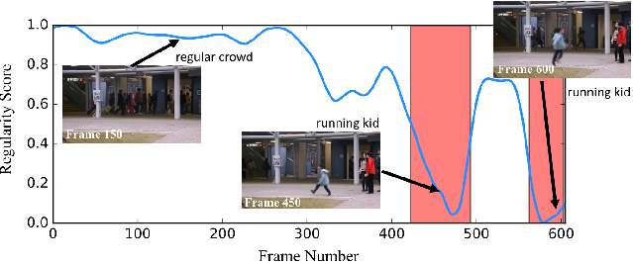
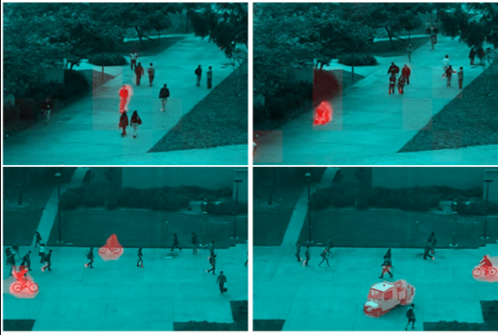
Recognition: Abnormal Event Detection
Learn normal patterns
Detect any thing deviating from normal as abnormal

Slide 30
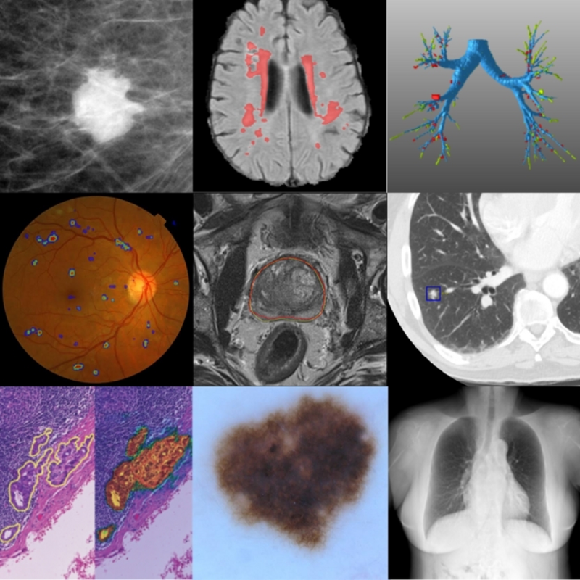
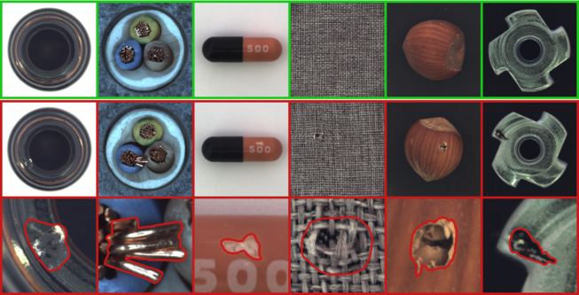
Recognition: Medical Anomaly Detection
Medical Image Anomaly Detection
Industrial Image Anomaly Detection

Slide 31
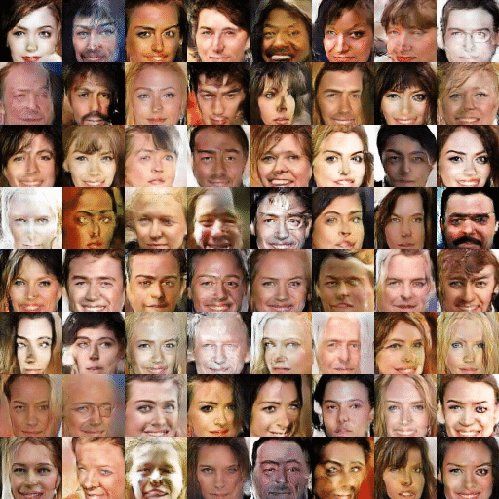
Generation: Image Synthesis
Use GANs for image generation
DC GAN

Slide 32
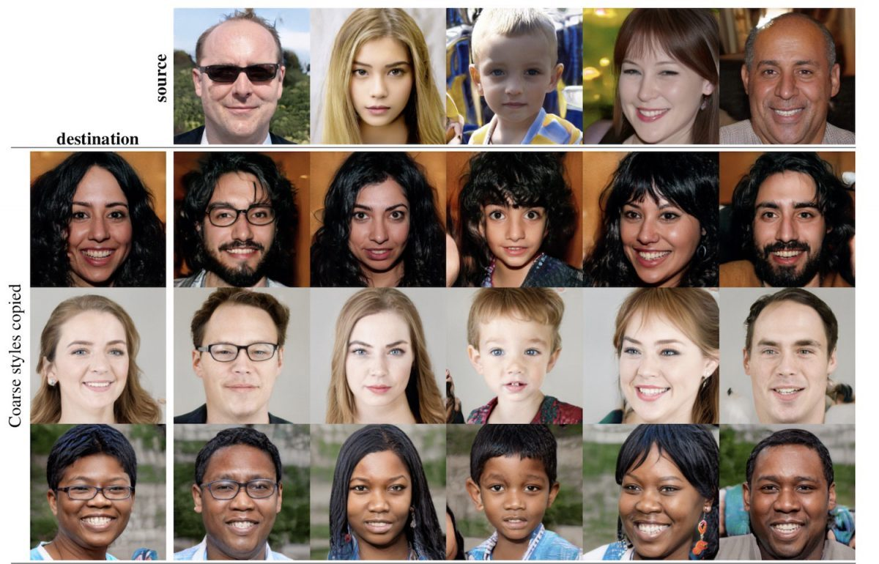
Generation: Image Generation based on an attribute
GANS generate new inputs based on attribute/pose given a input
Style GAN

Slide 33
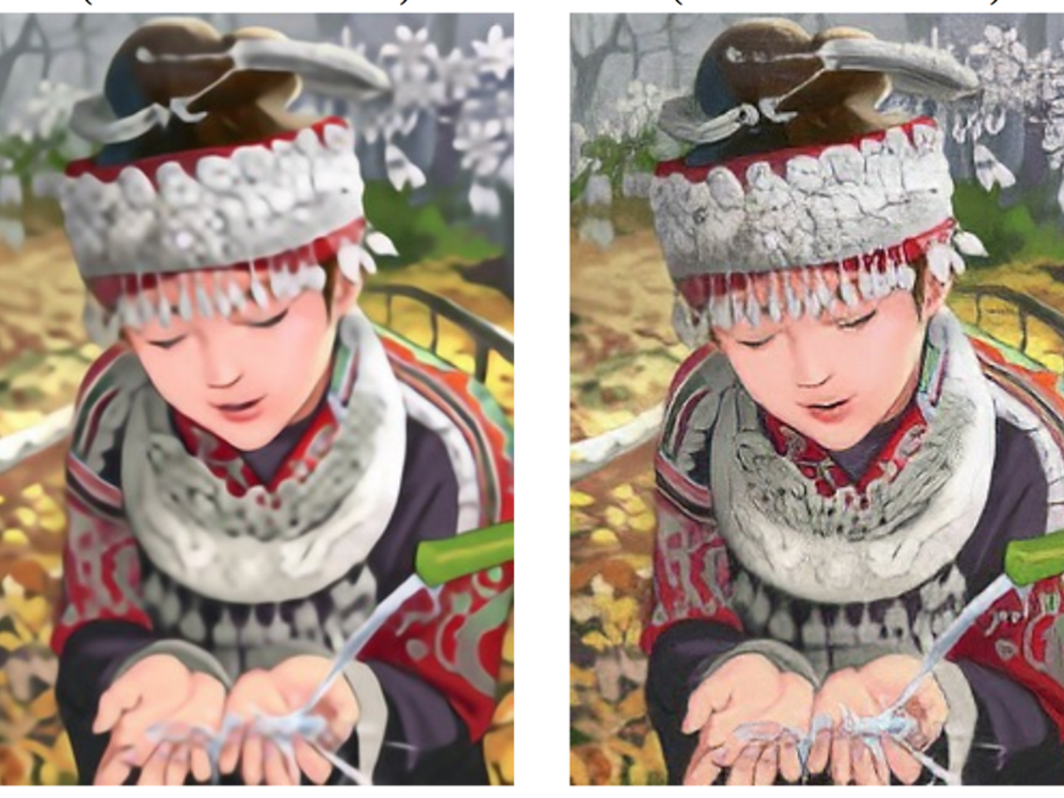
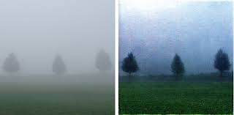
Generation: Other Applications
Super Resolution
Haze Removal

Slide 34
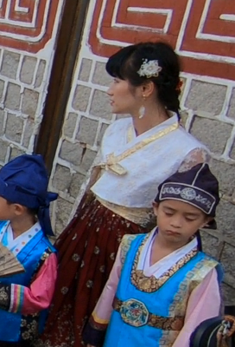

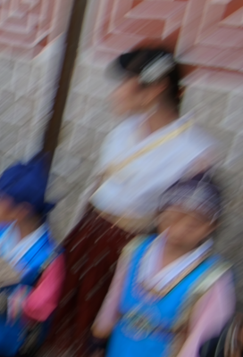
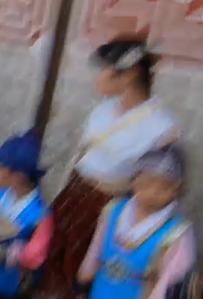
Image Artifacts
Clean
Low-Resolution
Motion Blur
Blur &
Compression

Slide 35
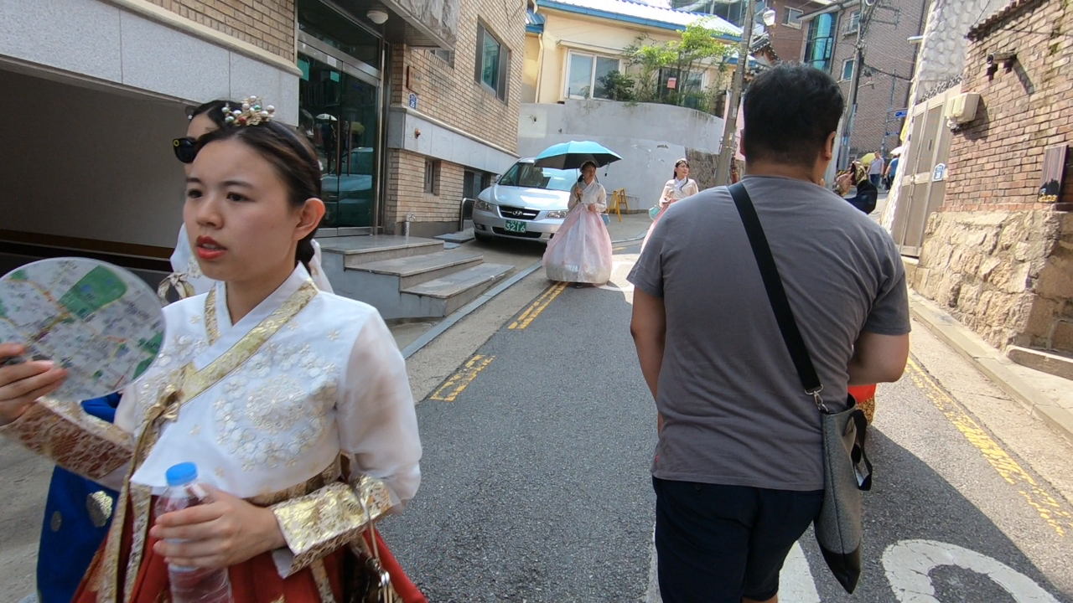
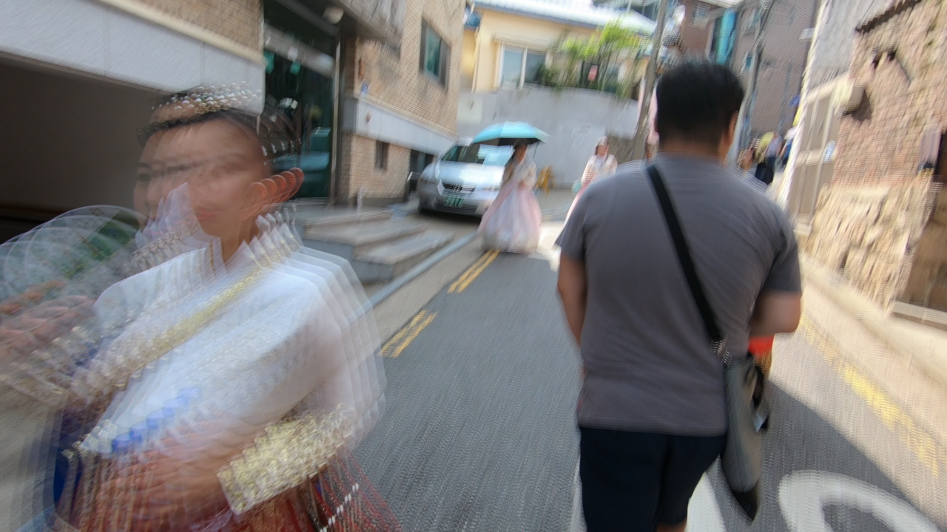
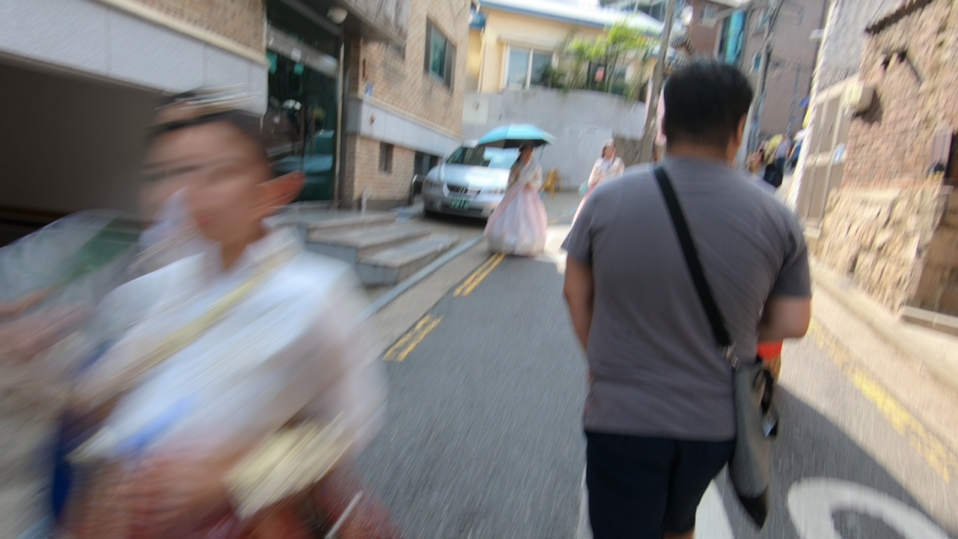
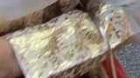
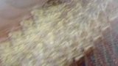
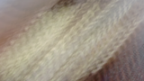


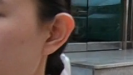
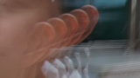
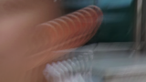
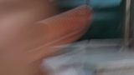
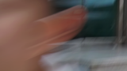
Blur Examples
(a) Sharp
(b) Blur (120 fps)
(c) Blur (1920 fps)
(d) Sharp
(e) Blur (120 fps)
(f) Blur (240 fps)
(g) Blur (480 fps)
(h) Blur (1920 fps)

Slide 36
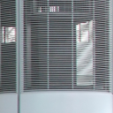
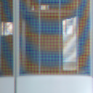


Moire Examples
Sharp
Moire
Sharp
Moire

Slide 37
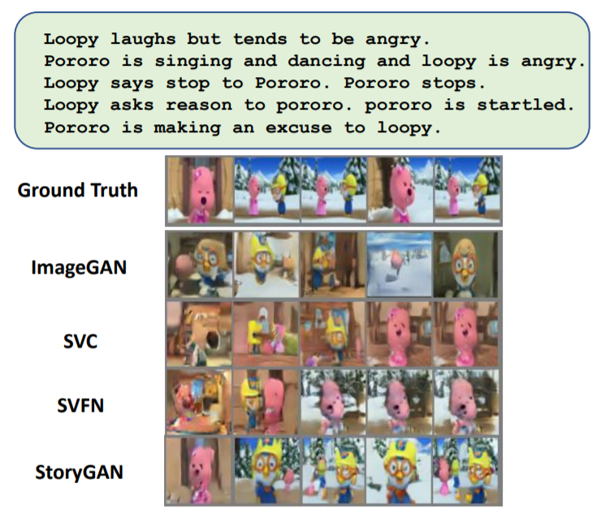
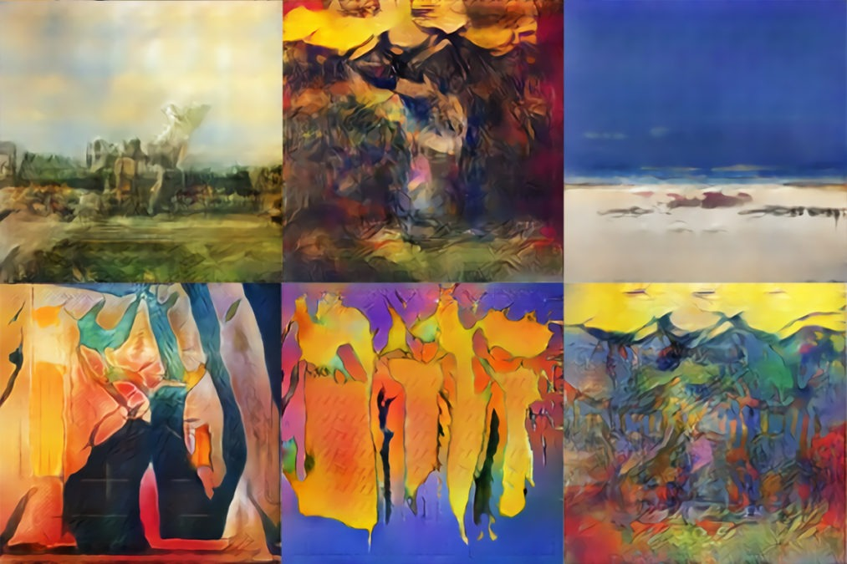
Creativity
Art Work by GAN
Generate images from captions
GANs are also used for creative applications like generating images based on a caption and creating new artwork

Slide 38
Computer Vision: Other Research
3D Reconstruction
Embedded Vision
Explainable AI in computer vision
Single Shot and Zero Shot Recognition
Fake Image/Video Detection

Slide 39
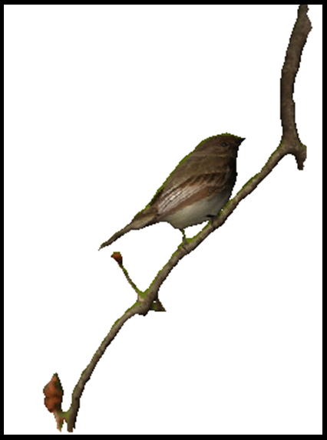
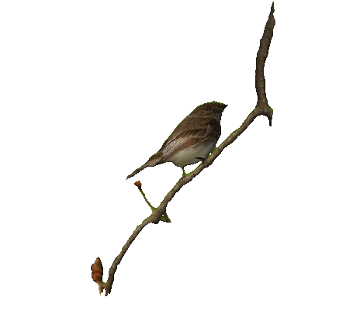
3D reconstruction
Recover the 3D properties of a geometric entity from its 2D images

Slide 40


3D reconstruction
3D reconstruction can be done from
Single image - monocular cue:shade, texture
Two images - computational stereo
Multiple images - Structure From Motion

Slide 41


3D reconstruction: Application in Medical Imaging
Examples of using 3D reconstruction for medical applications

Slide 42

3D reconstruction: Modelling Structure of Protein
What any given protein can do depends on its unique 3D structure.
The ability to predict a protein’s shape is useful to scientists because it is fundamental to understanding its role within the body, as well as diagnosing and treating diseases believed to be caused by misfolded proteins, such as Alzheimer’s, Parkinson’s, Huntington’s and cystic fibrosis.

Slide 43

3D reconstruction: Simultaneous Localisation and Mapping
Mapping : building a map of the environment which the robot is in.
Localization : navigating this environment using the map while keeping track of the robot’s relative position and orientation

Slide 44

Edge Revolution: Embedded Vision
CNNs are developed for clusters of CPUs and GPUs which consume about 80 and 200W respectively,
Real processing need to be done in limited power environment: mobile platforms : 5-10W, wearable devices: 0.1-1W

Slide 45
Edge Revolution: Embedded Vision
Embedded Vision: Integrates camera and processing board
Small computers on the “edge”: on devices ranging from wearables and mobile phones to embedded processors in car
Achieved by
Using specialized hardware
Optimization of algorithm: Weights of CNN

Slide 46
Edge Revolution: Embedded Vision
Optimizing algorithm
Choose right CNN architecture
top performing with smallest number of parameters.
Setting some weights to 0
Set less important weights to 0 with moderate effect on accuracy
Quantizing weights to fewer bits
Reduce computation using smaller number of bits to represent weights
Weights Deduplication
Eliminate duplicate or redundant information
Computation increase can be offset by
Integer/Fixed point arithmetic instead of floats
Approximate/Imprecise computation
Use less precision / fewer bits
Do convolutions in frequency domain

Slide 47

Explainable AI
Novel AI-models explaining why image classification or segmentation was done so

Slide 48
Single Shot and Zero Shot Recognition
Training from minimum number of data for recognition is an evolving area of research

Slide 49

Fake Image/Video Detection
GANs can generate realistic fake images which can be misused. Identifying fake image and deep model which generated it forms another area of research

Slide 50

Classical Computer Vision

Slide 51
Classical Computer Vision
feature based
Edges
Colour
HOG
SIFT
SURF

Slide 52
Recognition: Image Classification
CIFAR 10
10 object classes
50000 training images
10,000 test images
Accuracy: 99.5%
IMAGENET
1000 object classes
1,281,167 training images
100,000 test images
Top 1 Accuracy: 90.88%
Image classification on standard datasets have achieved good Accuracy

Slide 53

DL for Computer Vision : from 2012 onwards
Results on ILSVRC dataset

Slide 54
What all we cover in this course
Convolutional neural Networks
Alexnet
VGGnet
Resnet
Generative Adversarial Networks (GAN)
Transformers

Slide 55
Top Vision/ML conferences
Computer Vision
IEEE International Conference on CVPR(Computer Vision and Pattern Recognition )
ICCV (International Conference on Computer Vision)
ECCV(European Conference on Computer Vision)
WACV(Winter Conference on Applications of Computer Vision)

Slide 56
Top Vision/ML conferences
Machine Learning
NeurIPS (Conference on Neural Information Processing Systems)
ICML(International Conference on Machine Learning)
ICLR(International Conference on Learning Representations)
AAAI(Association for the Advancement of Artificial Intelligence)

Slide 57
Our Vision
To emerge as a world-class university in creating and disseminating knowledge and providing students with a unique learning experience in their chosen field of scholarship, that would best serve the society.

Slide 58
Relevant papers
Imagenet classification with deep convolutional neural networks A Krizhevsky, I Sutskever, GE Hinton
Proceedings of the 25th International Conference on Neural
Information Processing Systems (Lake Tahoe, NV, Dec. 2012), 1097 –1105 (2012): 120054 citations
Very deep convolutional networks for large-scale image recognitionK Simonyan, A Zisserman
arXiv preprint arXiv:1409.1556 (2014) : 91005 citations

Slide 59
Relevant papers
Deep Residual Learning for Image RecognitionK He, X Zhang, S Ren, J Sun
Computer Vision and Pattern Recognition (CVPR), 2016 : 147081 citations
Generative adversarial networksI Goodfellow, J Pouget-Abadie, M Mirza, B Xu, D Warde-Farley, S Ozair, ... (NIPS 2014) : 52737 citations
Attention is all you needA Vaswani, N Shazeer, N Parmar, J Uszkoreit, L Jones, AN Gomez, ...
Advances in neural information processing systems 30 (2017): 59227 citations

Slide 60
References
Images taken from different sources from the internet

